Slide 1



PREDICTING SOLAR POWER OUTPUT USING LINEAR REGRESSION

Slide 2

Learning Objectives
When predicting solar power output using linear regression, the primary learning objective is to develop a model that can accurately estimate the amount of solar power generated based on readily available weather data like solar irradiance, temperature, and cloud cover, by identifying the linear relationships between these variables and the resulting solar power output; this allows for efficient planning and management of solar energy production within a grid system by providing reliable forecasts.
GOAL
Source :
www.freepik.com/

Slide 3
Tools and Technology used
When predicting solar power output using linear regression, the primary tools and technologies involve:
Python: Popular for its simplicity and extensive libraries, including scikit-learn, Pandas, and NumPy.
Libraries and Frameworks:
a. scikit-learn : Provides implementation of linear regression and other machine learning algorithms.
Data Analysis and Visualization:
1. Pandas : For data manipulation and analysis.
2. NumPy : For numerical computing.
3. Matplotlib : For data visualization.
4. Seaborn : Based on Matplotlib, provides a high-level interface for drawing attractive and informative statistical graphics.

Slide 4
Methodology
When predicting solar power using linear regression, the primary methodology involves establishing a linear relationship between weather variables like solar irradiance, temperature, humidity, and cloud cover (independent variables) with the predicted solar power output (dependent variable).
Machine Learning (ML) Models are used for forecasting the solar power generation weather analysis.

Slide 5
Problem Statement:
Solar power plant wants to predict its power output for the next day based on historical weather data.
The plant has collected data on various weather parameters such as temperature, humidity, wind speed, and solar irradiance, along with the corresponding power output.
It is possible to establish a relationship between these variables and predict future solar radiation based on weather patterns

Slide 6
Solution:
To improve the accuracy of our predictions, we have implemented Hyper-parameter Tuning, which allows us to fine-tune the parameters of each algorithm to achieve the best results.
We aim to identify the most effective and efficient method for predicting solar radiation based on weather data by testing and optimizing these various regression models.
By leveraging advanced regression algorithms and models, as well as Hyper-parameter Tuning and we can provide utilities with more reliable and precise predictions, ultimately reducing costs and increasing efficiency in the power generation industry.

Slide 7
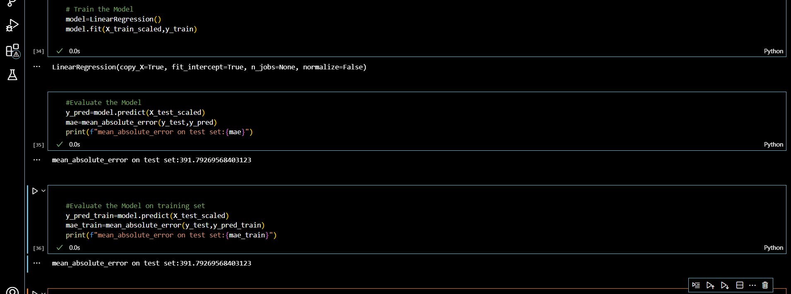
Screenshot of Output:

Slide 8
Conclusion:
The study applied various regression algorithms to determine the optimal model for predicting solar radiation. The findings indicate that Linear Regression yielded the most accurate predictions

